Slide 1
Guidance Utility for Impaired Daily Experiences
Jack Letsinger, Jack Couture, Alyan Tharani, Diana Canchola, Ryan Wu, Noah Kilpatrick

Slide 2
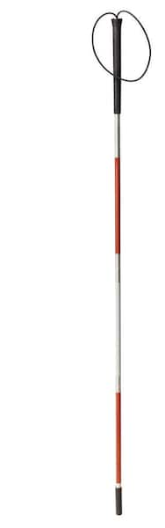
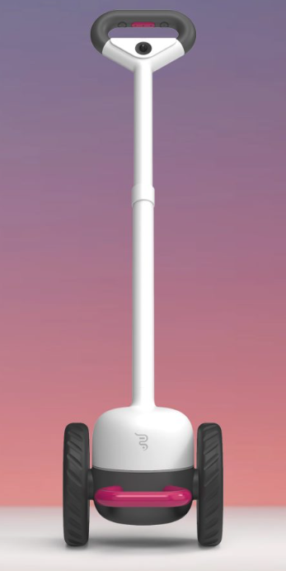
Problem
Development Timeline
1931
White Cane is formally recognized as a tool for the blind
1947
Collapsible cane is developed by Dr.Richard Hoover
Widely used
Little to no
innovation
Compromises:
compatibility
mobility
1921
White cane is invented by James Biggs
1935
The long cane is developed for navigation by Dr.Richard Hoover
21st Century
Adoption of electronic sensors
GPS
Ultrasonic
smart apps
Notes:
Alyan
Highlight there is a lot of movement in the early 1900s but then falls silent
We are seeing a lot of innovation with smart canes and sensors but it isn’t being widely adopted
The main problem is the widely used white cane hasn’t been innovated and is limited, the user doesn’t know about the obstacle until it is directly in front of it.
New canes compromise mobility and compactibility because they’re bulky and expensive

Slide 3
Need
21st century solution to a humanity-long impairment
Incorporate modern sensors and algorithms to provide a better picture of environment for the visually impaired
Full spatial awareness with real-time feedback
Device familiar to the users that will enhance their independence and quality of life
Notes:
Alyan
Main needs are for the user to have full awareness of their surroundings so they understand their environment better
We need to bring 21st century sensors and algorithms to a humanity-long impairment
Leverage a tool familiar to the users but enhance it so they can be more mobile and independent

Slide 4



Goals & Objectives
Detect obstacles up to 2m away from the user
Alert the user through the use of handle vibrations
At the 2m, 1m, 0.5m, and 0m distances
Allow the user to adjust the handle vibrations for sensitivity
Full Mobility
Detect Obstacles
Alert Users
Notes:
Ryan Wu
Three main goals for our project
Increase independence for the visually impaired by enabling full mobility in college campuses
Detect Obstacles 2m away from them
Alert users through handle vibrations, explain how the vibrations will change as the obstacle gets closer

Slide 5




Design Constraints
Lightweight design for full mobility.
1.5lb - 1.75lb in total weight
Durable battery life for day-long use.
3-4 hours of use in one charge
Real-time feedback with little to no delay.
< 0.5 seconds
Size
Weight
Battery Life
Low Latency
Notes:
Ryan Wu
The design constraints are mainly focused around creating the best user experience without compromising functionality
Has to be a small addition to the cane to keep it collapsable and lightweight
Has to last at least 3-4 hours
Has to have near instantaneous feedback to the user about obstacles

Slide 6
Alternate Solutions
Smart Cane with phone app to audibly alert users of obstacles
Audio could impair hearing
SLAM Algorithm to add obstacles into a database
Stretch goal
Infrared Sensor for object detection
Access to other sensors
Belt or bag for users to carry along with the cane
Added baggage for users, eliminates portability
Notes:
Noah
These are ideas we had for the project but we didn’t add in
Discuss the pros and cons of each
1. Phone App
Pro: Have one place where the user could interface with the tool
Con: Audio could impair the hearing of the user and the people around them, the application would have to be accessible to the user
2. SLAM Algorithm
Idea behind this is to track the obstacles the user encounters to build a database and have the cane be smarter by knowing when to anticipate them
Pro: Makes our cane smarter
Con: We set this as a stretch goal if we have time
3. IR Sensor
Pro: Added sensor for increased awareness
Con: We already had access to a depth camera and lidar, pairing the two made most sense to get a picture and distance
4. Bag
Pro: Provide a way to store batteries and wires in a wearable way
Con: Added component for users that may be cumbersome

Slide 7
OUR SOLUTION

Slide 8
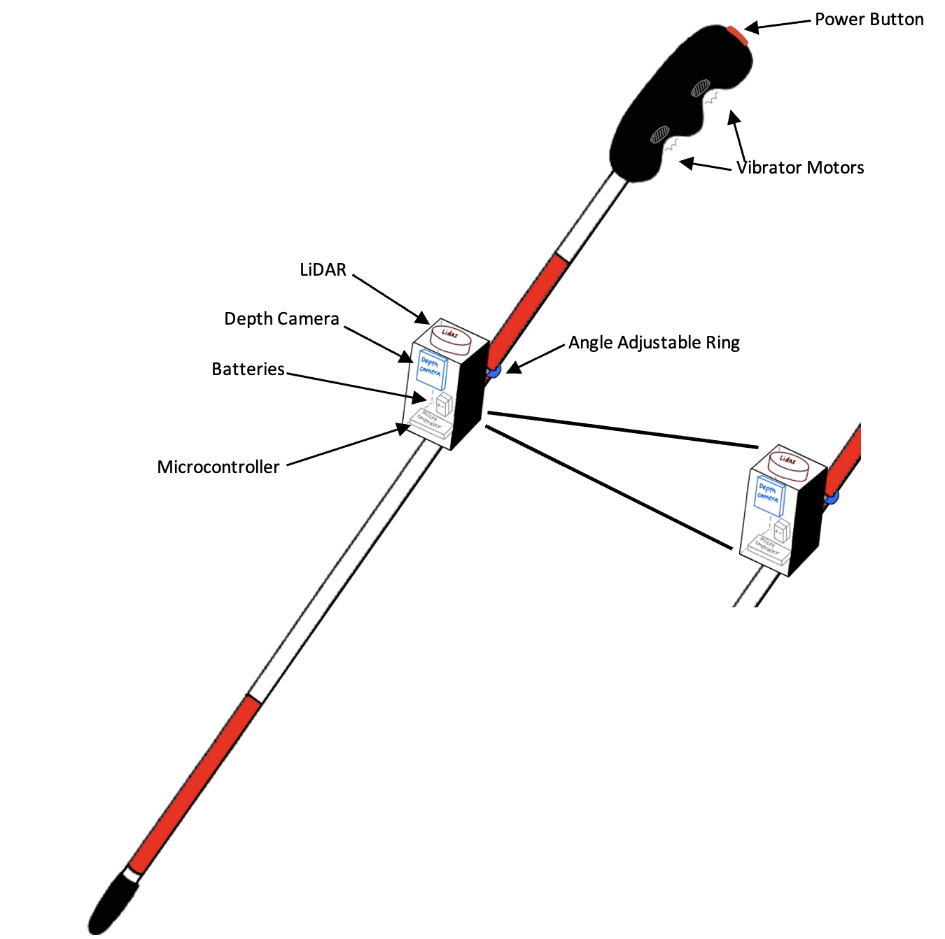
Updated Proposed Design
Internal/External Design
Externally
No major external changes
Working (electrical/functional) breadboard prototype complete
Still working out (mechanical) implementation of sensor mount
Internally
Single rechargeable 9V Battery to replace multiple 1.5V batteries in series
Choice of Python > C++
Notes:
Noah

Slide 9
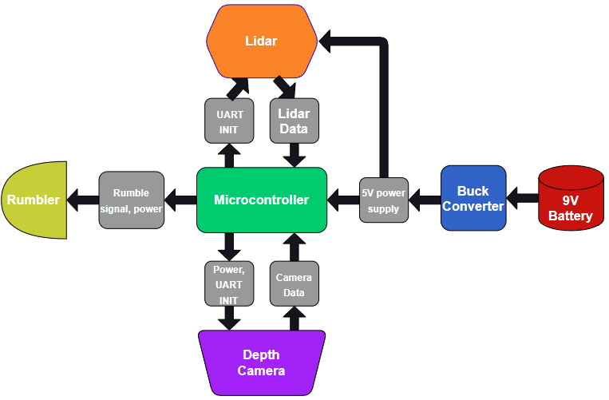
System Description
Overall System Design
Initial Proposal
All sensors, microcontrollers, and feedback working the same as initially drafted
Changes
Buck converter will step down the 5V input for all devices
Due to the # of terminals on the Converter, the depth camera will be powered through the Pi.
Notes:
Ryan
Buck converter due to 9V battery
Using 9V battery due to size
Most of our components use 5V
Bc not enough terminals on the converter, use raspi pico to power the depth camera
We connect the LiDAR and the Depth camera to the raspi pico through the UART so that we can receive data in readable form.
Connect vibration motors to the GPIO pins on the raspi pico

Slide 10
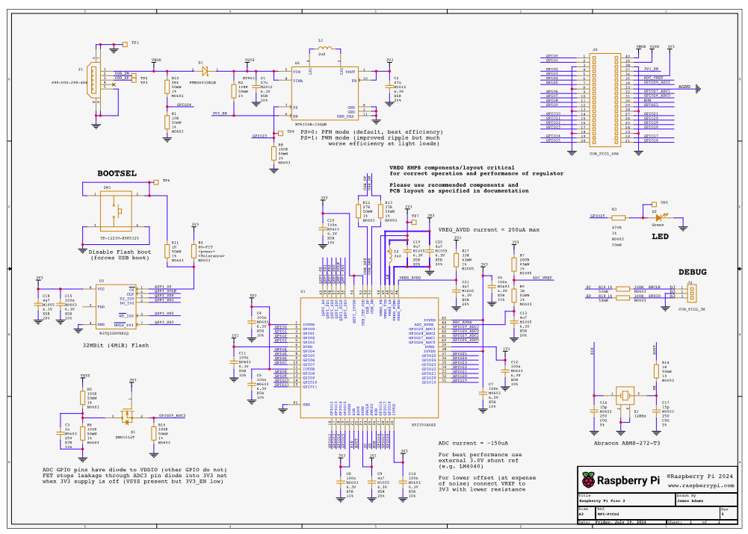
System Description (Cont.)
Component Specific Details
Raspberry Pi Pico
Handles all communication between each system part
Dual-core ARM Cortex-M33 processor provides a sufficient clock speed (150 MHz) to handle computation
21 mm x 51 mm size, 1.8-5.5V input power
9V Battery
48.8 mm x 26.0 mm, 0.265 lbs
Stronger, rechargeable battery reduces overall size
Buck Converter
22 mm x 17 mm, 0.106 oz
Converts 9V battery input to 5V input for components
Notes:
Ryan
Buck converter due to 9V battery
Using 9V battery due to size
Most of our components use 5V
Bc not enough terminals on the converter, use raspi pico to power the depth camera
We connect the LiDAR and the Depth camera to the raspi pico through the UART so that we can receive data in readable form.
Connect vibration motors to the GPIO pins on the raspi pico

Slide 11
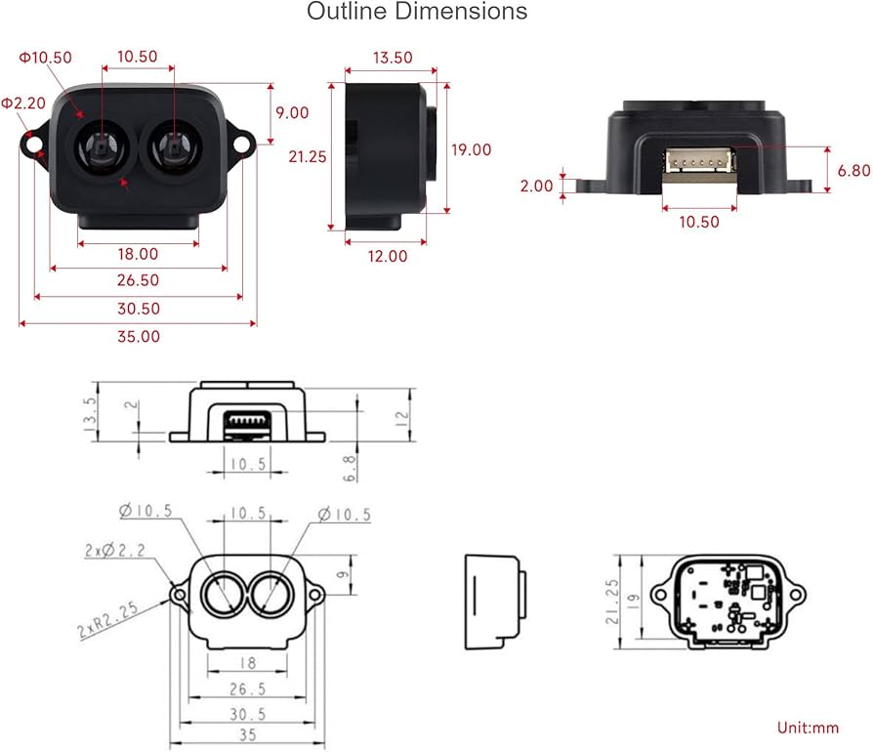
System Description (Cont.)
Component Specific Details
Depth Camera
10mm x 2.7 mm
Powered through Pico
19 ms - 25 ms response time
LiDAR
10mm x 2.7 mm
8 ms - 11 ms response time
Notes:
Ryan
Buck converter due to 9V battery
Using 9V battery due to size
Most of our components use 5V
Bc not enough terminals on the converter, use raspi pico to power the depth camera
We connect the LiDAR and the Depth camera to the raspi pico through the UART so that we can receive data in readable form.
Connect vibration motors to the GPIO pins on the raspi pico

Slide 12
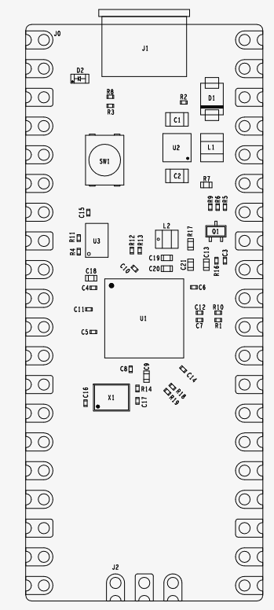
Hardware
The Use Case:
Sensors, brought together by a microcontroller, must:
Accurately paint a picture for the user
Be lightweight and easily transportable
Be energy efficient for a suitable battery life
While each piece of hardware and their codebase already exist, the effectiveness of the design will come from the integration of all components to a final product.
Notes:
Jack L

Slide 13
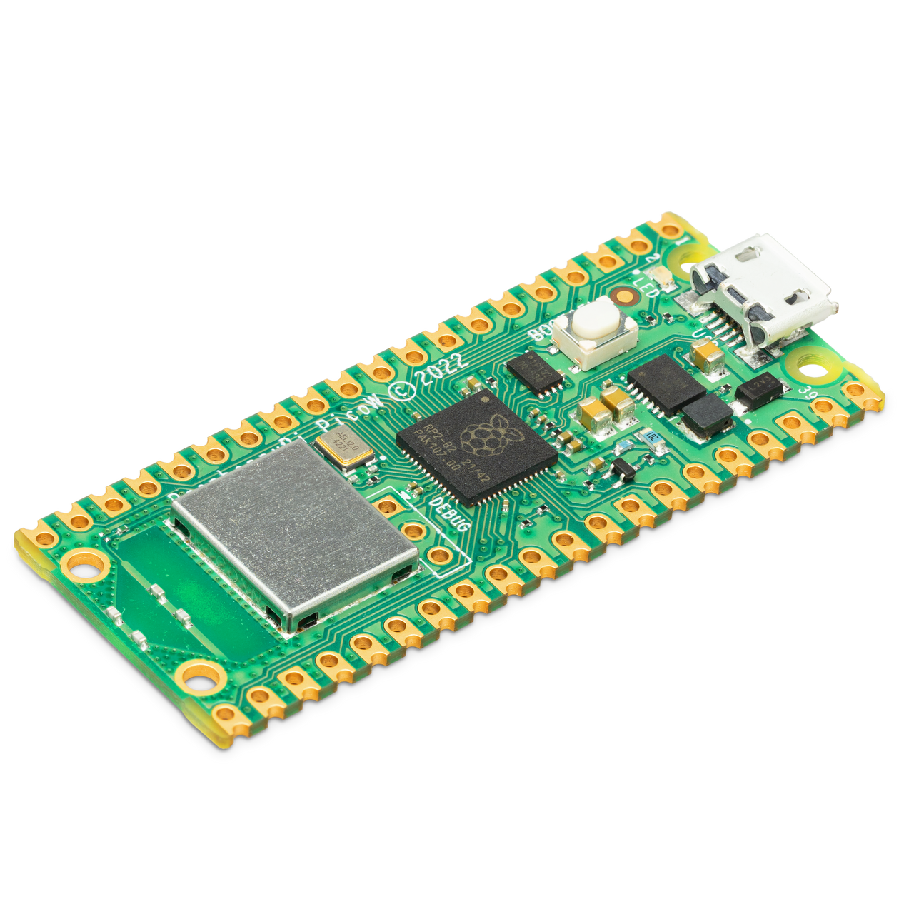
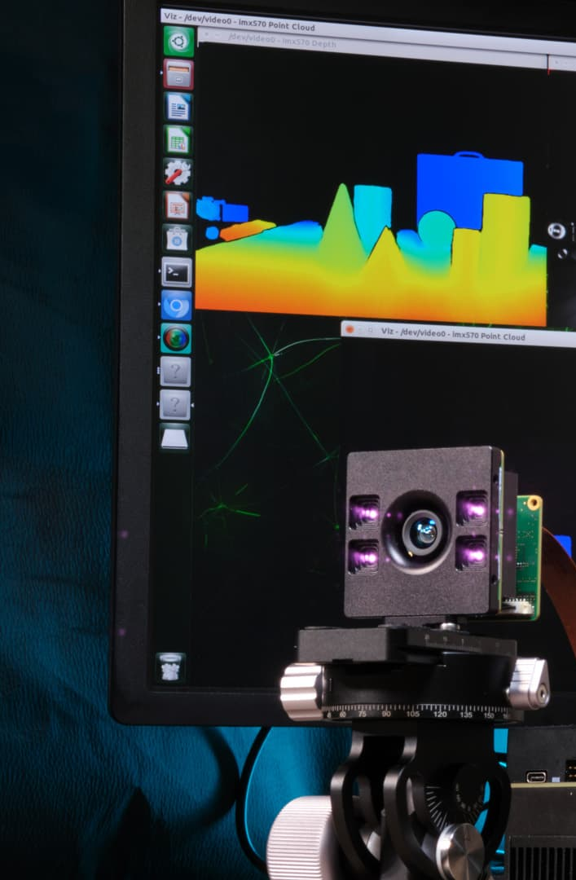
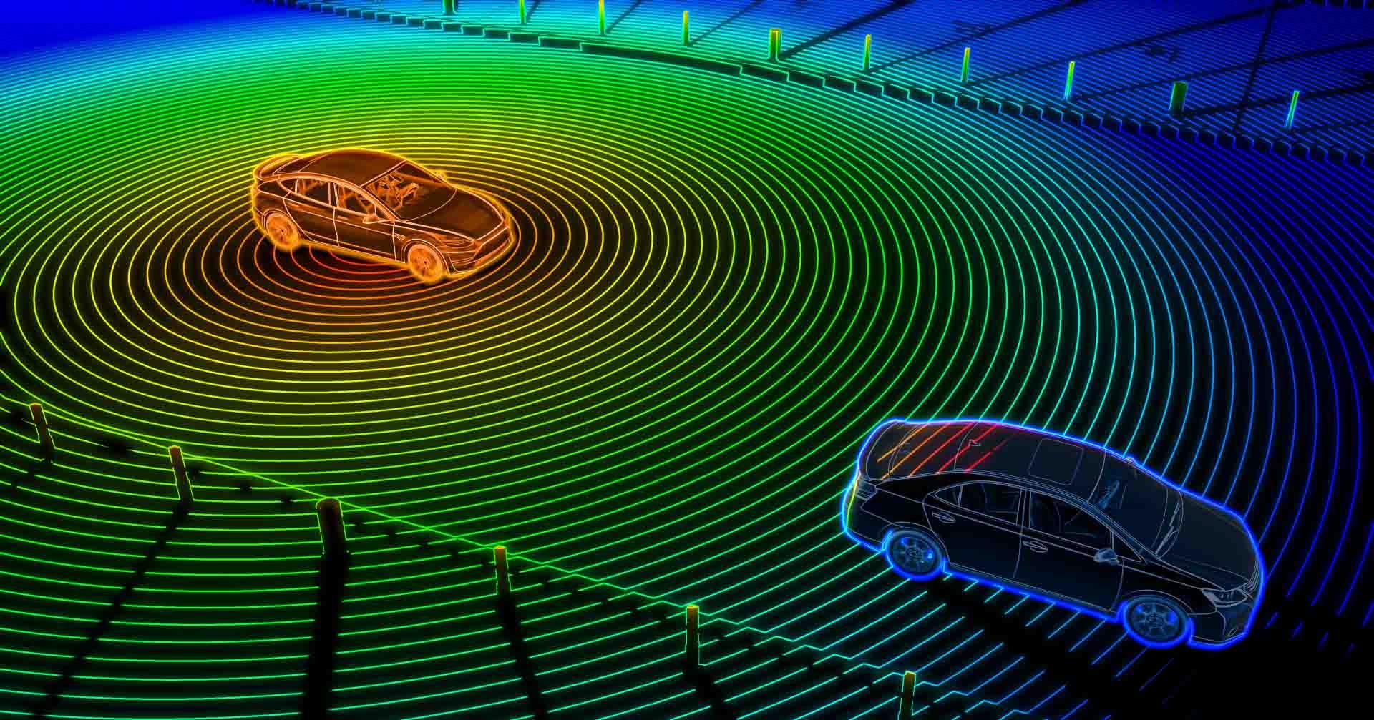
Hardware (Cont.)
Microcontroller: Raspberry Pi Pico 2
Extremely power efficient
UART/Serial port capabilities (as opposed to I2C or SPI)
Python/C/C++ capabilities, access to the Raspberry PI SDK.
Lidar vs. Depth Cameras
Both provide “vision”
Lidar scans provide a rapidly updating distance of objects in front of it (single value)
Depth camera measures objects in a frontal cone pattern (image)
Rumbler
Haptic feedback will alert the user of nearby objects in the probed direction
Our project plans to utilize multiple types of sensors
Notes:
Jack L

Slide 14

Software
The Design:
Python scripts on microcontroller:
C++ lacks the libraries Python has
More comfortable to work with
More easily integrates
Negligible latency
AI/ML
Take both depth camera and LiDAR data and determine how the distance should be calculated
Weighted Average based on accuracy at different angles or ranges could be a potential solution
Notes:
Jack C

Slide 15
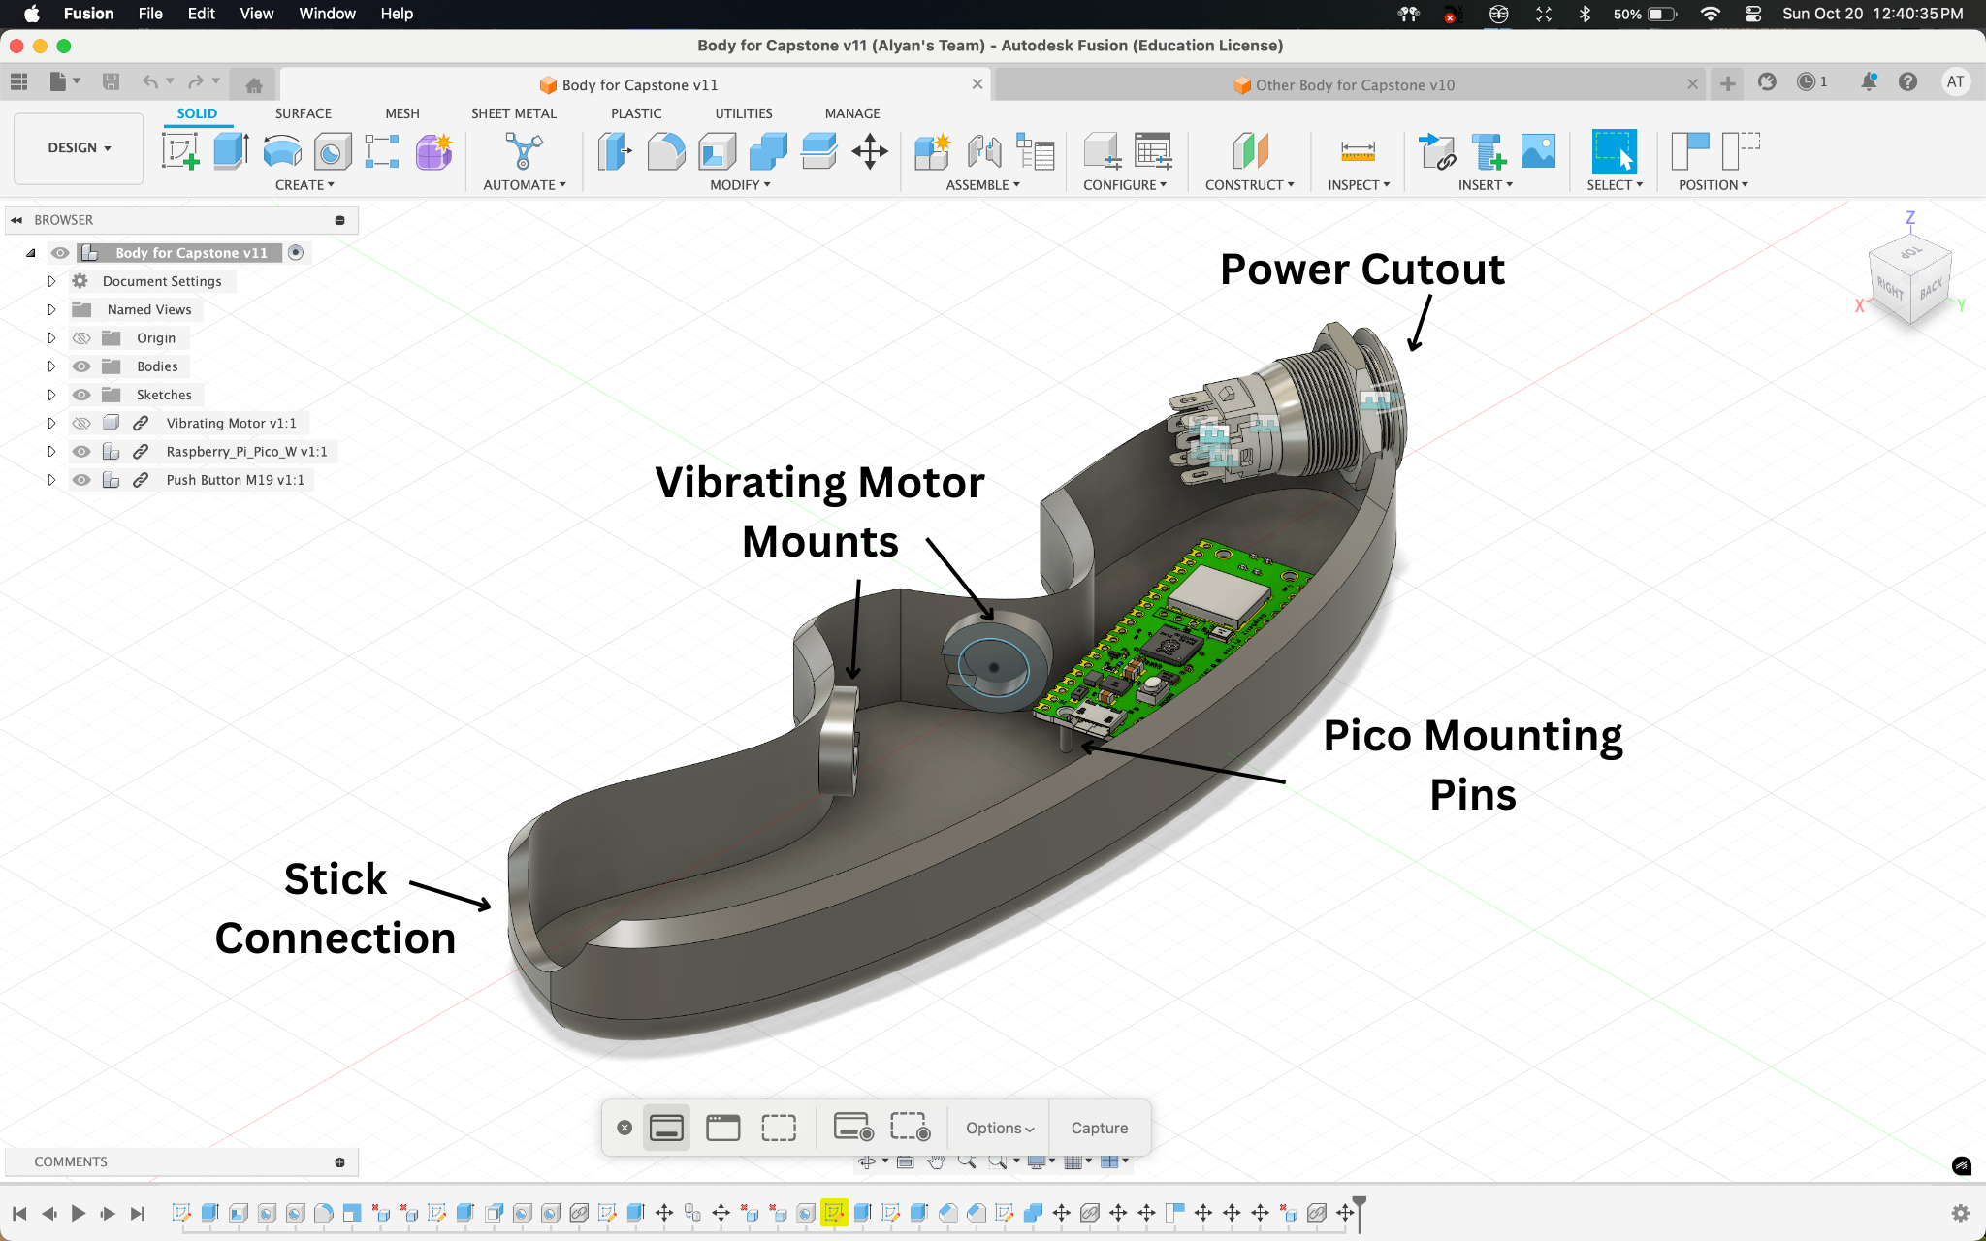
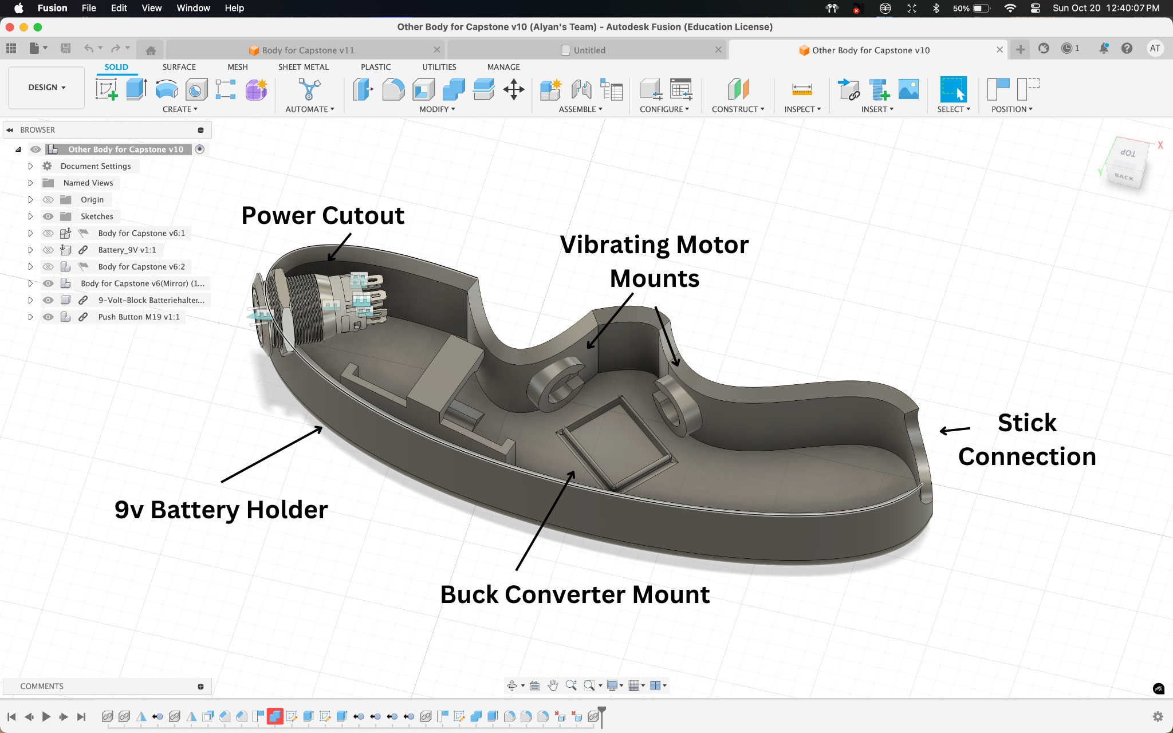
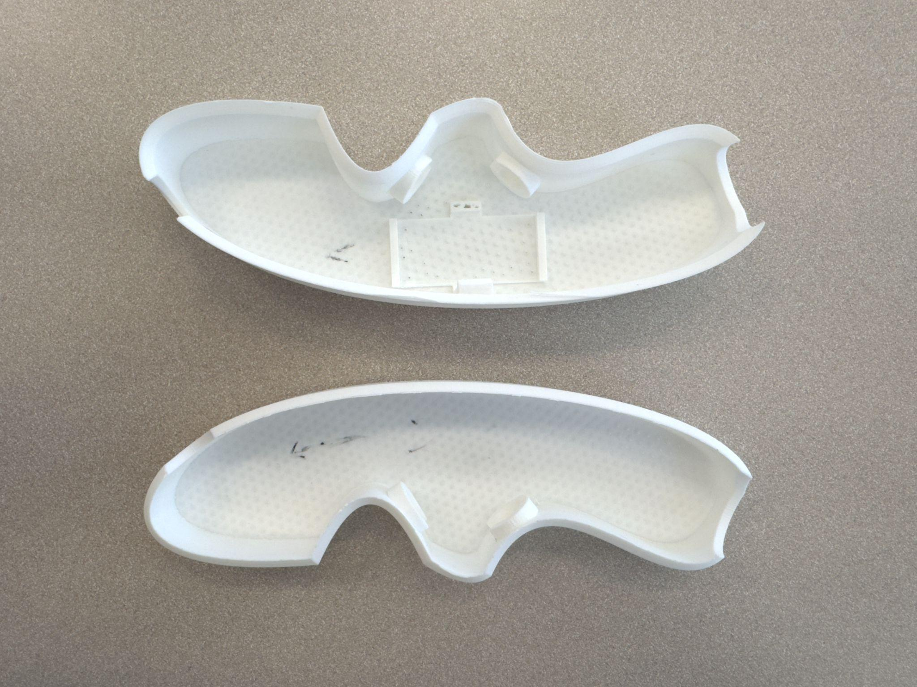
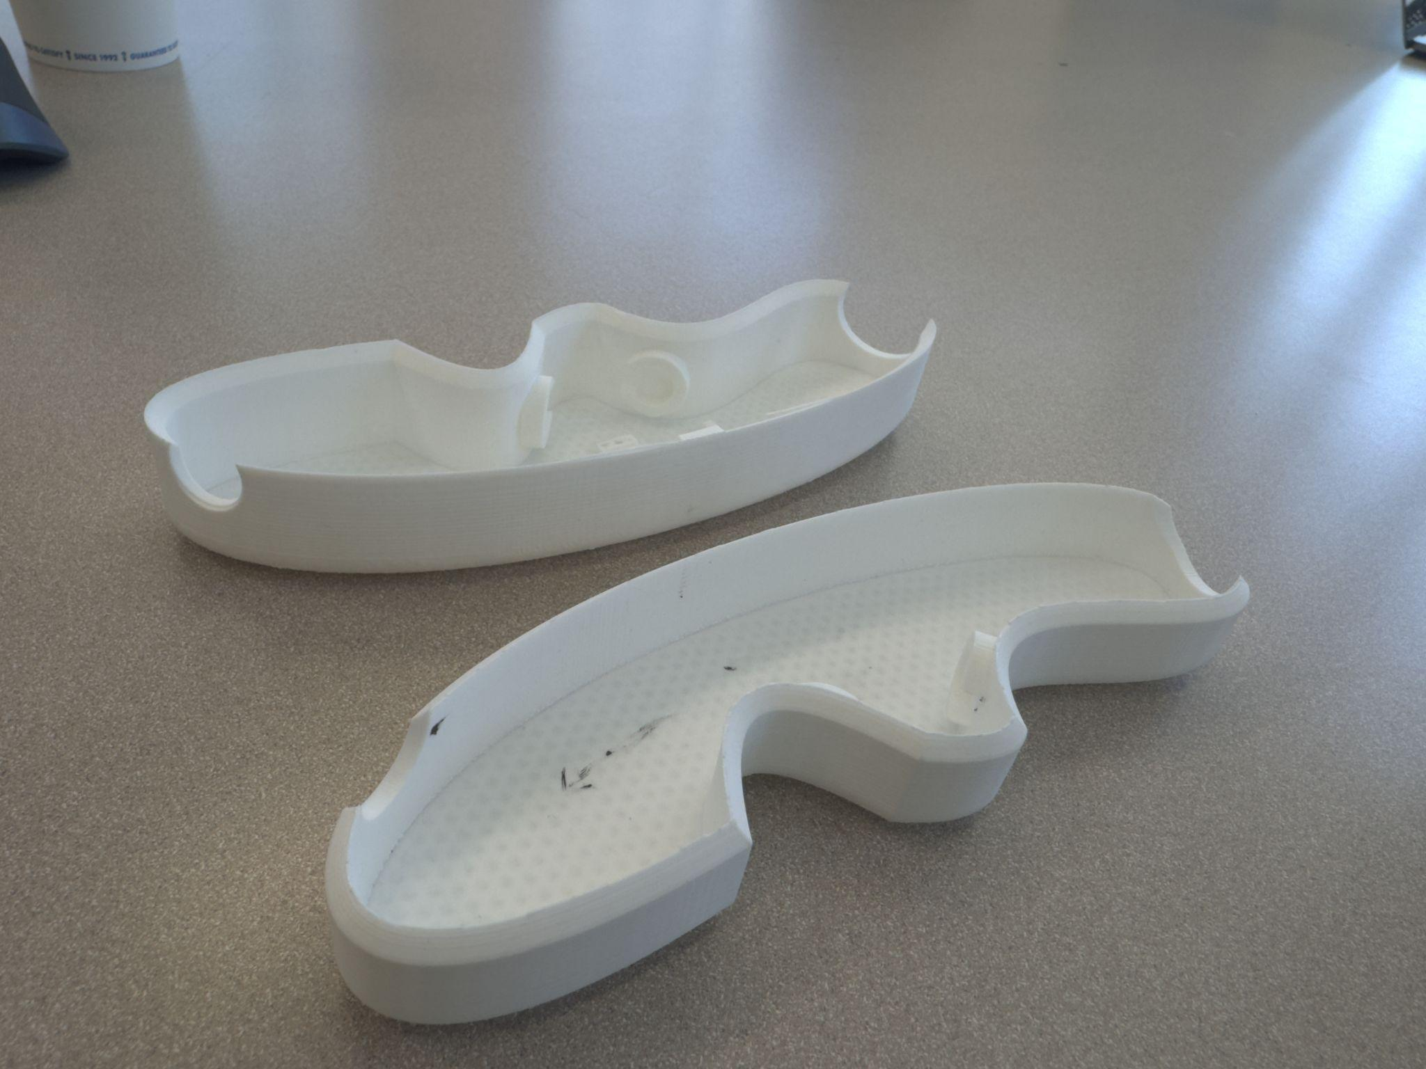
3D Modeling
Initial 3D Design of Handle
Updated 3D Design of Handle
Design Considerations
Comfortably fit all hardware except for sensors
Allow for vibrations to alert the user
Lightweight
Tightly fit onto the walking stick
Notes:
Alyan

Slide 16
Design Validation
Testing & Integration: 3-4 weeks allotted
Mobility
Weight of entire cane must be less than 2 lb
The cane must be collapsable as per the original design
The cane must easily be moved back and forth.
Full functionality should be available for 3-4 hours
Obstacle Detection
GUIDE will detect obstacles at least 2m away
Detection should be tested in sunny/cloudy/rainy conditions
GUIDE will be functional in grass, pavement, mulch, and dirt.
Detection should be tested on curbs, pedestrians, bikers, scooters, medians
User Alert
User will be alerted within 0.5 seconds of GUIDE algorithm determining obstacle.
Intensity of the vibrations will increase from 2m, 1m, 0.5m and 0m
Notes:
Jack C

Slide 17
Design Validation (Cont.)
Testing environment plan
Create evaluation platform using prototype with breadboard, spare pico, and simulated sensor values
Use this setup for testing while final product is in production
Allows for physical testing of cane, code can still be modified and tested
Incremental testing- a three step approach:
Individual component testing (serial port connectivity, power settings)
Integrated tests of all components together, with a 5V power supply
Full system testing with dedicated battery (final product)
Notes:
Jack C

Slide 18
TEAM MANAGEMENT

Slide 19
Budget
 | Amount | Amount per Unit | Cost per Unit | Dimensions | Weight | Total Amount ($)
Walking Stick | 1 | 1 | $17.99 | 53in x 0.5in - Rod 7in x 1in - Handle | 0.55lb | $17.99
Power Button | 1 | 1 | $9.99 | 16mm | 0.35 ounces | $9.99
Vibrating Motor | 2 | 8 | $7.59 | 10mm x 2.7mm | 0.63 ounces | $7.59
LiDAR | 1 | 1 | $23.99 | 10mm x 2.7mm | 0.176 ounces | $23.99
Depth Camera | 1 | 1 | $43.00 | 10mm x 2.7mm | 10.6 ounces | $43.00
Buck Converter | 1 | 6 | $1.67 | 22mm x 17 mm | 3g | $10
Raspberry Pi Pico 2 | 2 | 2 | $6.25 | 21mm x 51mm | 4g | $12.50
9V Battery Holder | 1 | 10 | $0.50 | 0.94"L x 0.47"W x 0.28"H | <1g | $4.99
9V Battery (Rechargeable) | 1 | 4 | $5.25 | 48.8mm x 26.0mm | 0.12kg | $20.99
PLA Printer Filament | 1 | 1 | $0.055 (per g) | N/A | 63g | $3.50
Angle Adjuster | 1 | 1 | $13.99 | 2.95” x 2.56” x 0.98” | 0.09kg | $13.99
Total (s) | N/A | N/A | N/A | N/A | 44.72 oz or 2.795 pounds | $168.53
Notes:
Diana

Slide 20
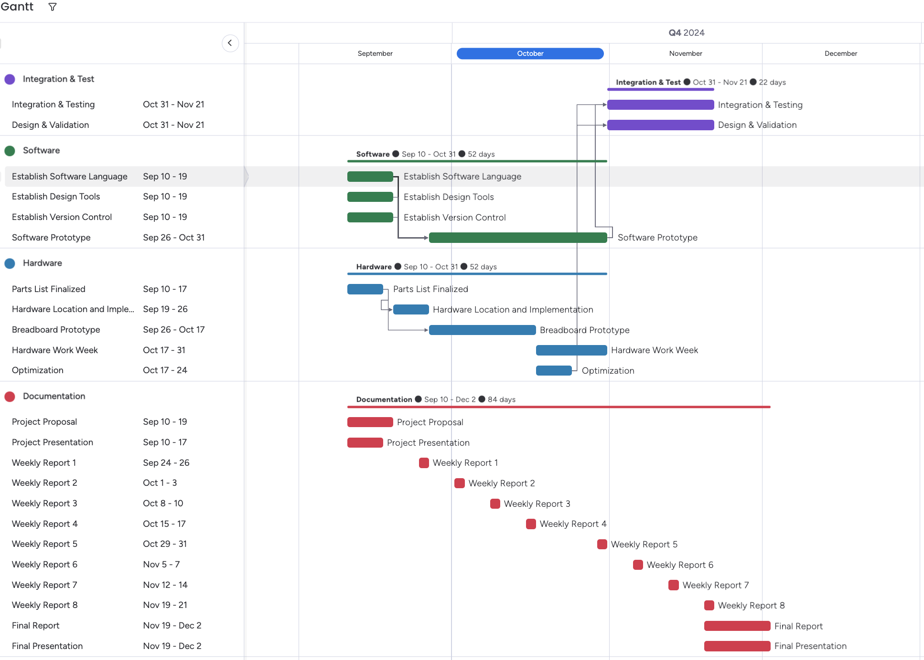
Schedule
Updated Schedule
Breadboard prototype was extended
Software Prototype was extended
No major disruption to the overall schedule
Notes:
Diana

Slide 21
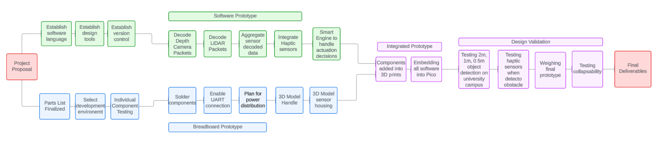
Implementation Schedule
Completed to Date
Next Steps for Implementation
Complete Software Prototype
Develop “smart” algorithm using AI/ML
Integrate software into Pico, add hardware to 3D prints and attach
Validation, Integration, and Testing
Completed to Date
Notes:
Diana

Slide 22
Project Management
Team | Leader | Members
Hardware | Jack Letsinger Finalize and order parts Oversee breadboard prototype Test sensor capabilities | Ryan Wu Soldering and component integration Breadboard prototype
 |  | Alyan Tharani GUIDE handle 3D modeling GUIDE electronic housing 3D modeling
Software | Jack Couture Oversee software prototype Depth Camera decoding script Depth Camera image generation | Noah Kilpatrick Sensor data packets decoding Depth Camera decoding script
 |  | Diana Canchola LiDAR data packet decoding LiDAR python script to output distances
Overall Lead: Diana Canchola
Notes:
Diana

Slide 23
Results

Slide 24
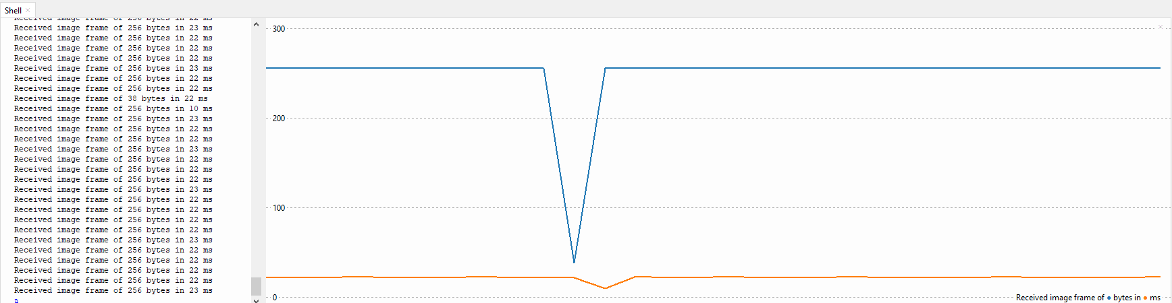
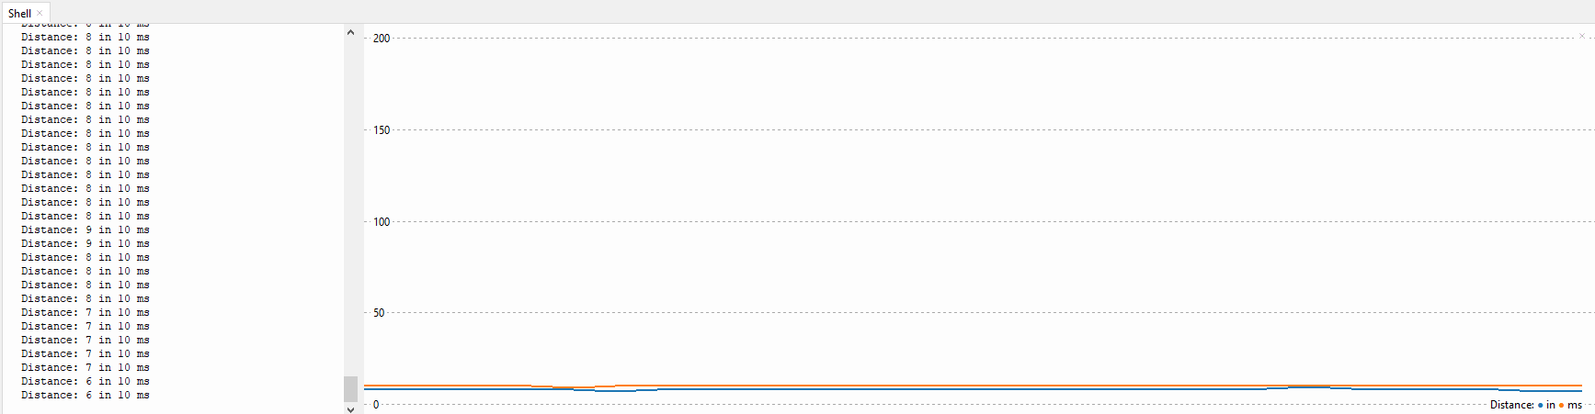
Initial Testing
Timing Waveforms
Initial results
Timing requirements in proposal set a goal of 0.5 seconds (500ms) to give the user a haptics response.
Results were better than expected, both in individual and combined sampling times
Even in a worst case scenario of 50ms, still 10x faster than initial proposal
No expected slowdown from using python over C/C++
 | No Lidar | Lidar
No Depth Camera | N/A | 9.97 ms
Depth Camera | 21.98 ms | 44.14 ms
Notes:
Jack L

Slide 25
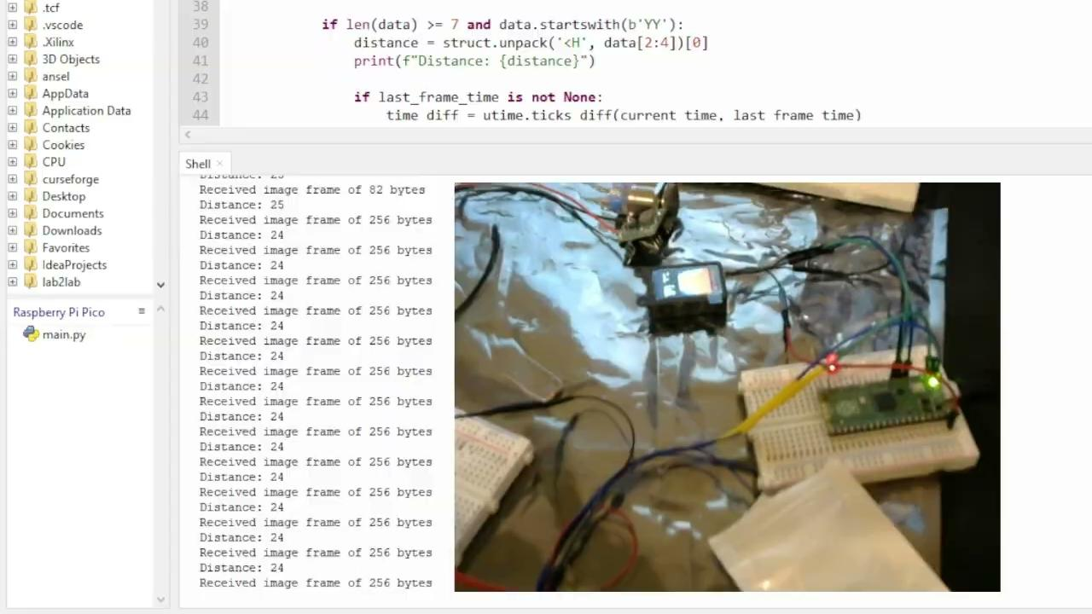
Demo Video
Notes:
Team

Slide 26
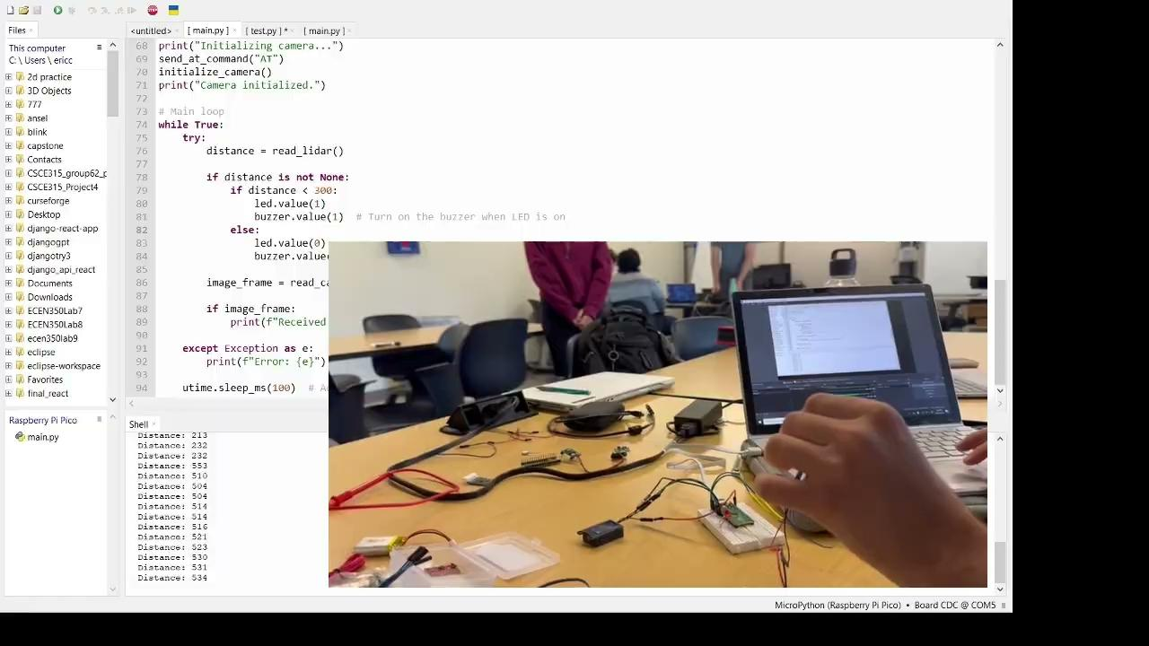
Demo Video
Notes:
Team

Slide 27
Final Demonstration Plan
Scenario 1
Location: EABA
Classroom objects scattered throughout the hallway
User will walk down the hallway and office area
Goals
Detect all obstacles in the hallway, show vibrations
Display chart with distances vs vibration frequency (2m, 1m, 0.5m)
Scenario 2
Location: EABA
Several people walking across the hallway
User will walk through the hallway and office area
Goals
Detect all of the people moving
Display chart with distances vs vibration frequency (2m, 1m, 0.5m)
Scenario 3
Location: Outside of EABA
Several people walking outside
Navigating a curb, medians, and sidewalks
Goals
Show GUIDE can navigate outdoor environments
Detect all outdoor obstacles
Display chart with distances vs vibration frequency (2m, 1m, 0.5m)
Notes:
Diana

